Slide 1

DC Circuits
School of Electrical Engineering

Slide 2
Introduction
Electric circuit has many elements like resistor, capacitor, inductor, battery etc.
Circuit analysis is the process by which voltage or current is measured across the element.
In a complete circuit there are two types of elements found active elements and passive elements.
The active elements generate energy: Batteries, generators, operational amplifiers etc are active elements.
The passive elements cannot generate energy, they drop energy: Resistor, capacitor, inductor etc are passive elements because they takes energy from circuit.

Slide 3
Introduction
In a complete circuit voltage or current source are most active elements which deliver power in the circuit.
An independent source can deliver or absorb energy continuously (without any limit)such element are called active element.
Two type of source
independent and
dependent source.
An ideal independent source is an active element that provides a specified voltage or current that is completely independent of other circuit elements.
An ideal voltage source is that element which supply voltage between two terminals to maintain current through the circuit.

Slide 4
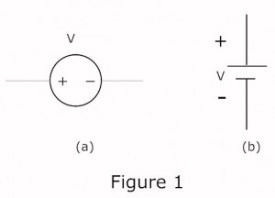
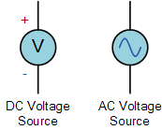
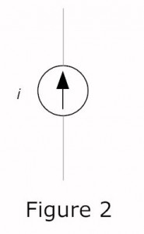
Voltage and current sources(independent)
Figure 1 (a) shows the symbol of time varying voltage source and figure 1(b) shows continuous dc voltage source.
An ideal independent current source is also an active element which supply a specified current to a circuit. Figure 2 shows the independent current source symbol where arrow sign indicates the direction of flowing current i.

Slide 5
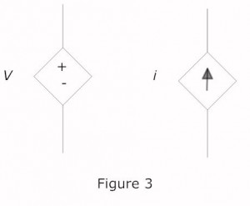
Voltage and current sources(dependent)
An ideal dependent source is an active element in which the source quantity is controlled by another voltage or current.
Figure 3 shows the symbol of dependent voltage and current source it is diamond shaped. Dependent source of voltage or current is controlled by other element in the circuit. There are four types of possible dependent are
A current controlled voltage source (CCVS),
A voltage controlled voltage source (VCVS),
A current controlled current source (CCCS),
A voltage controlled current source (VCCS).

Slide 6
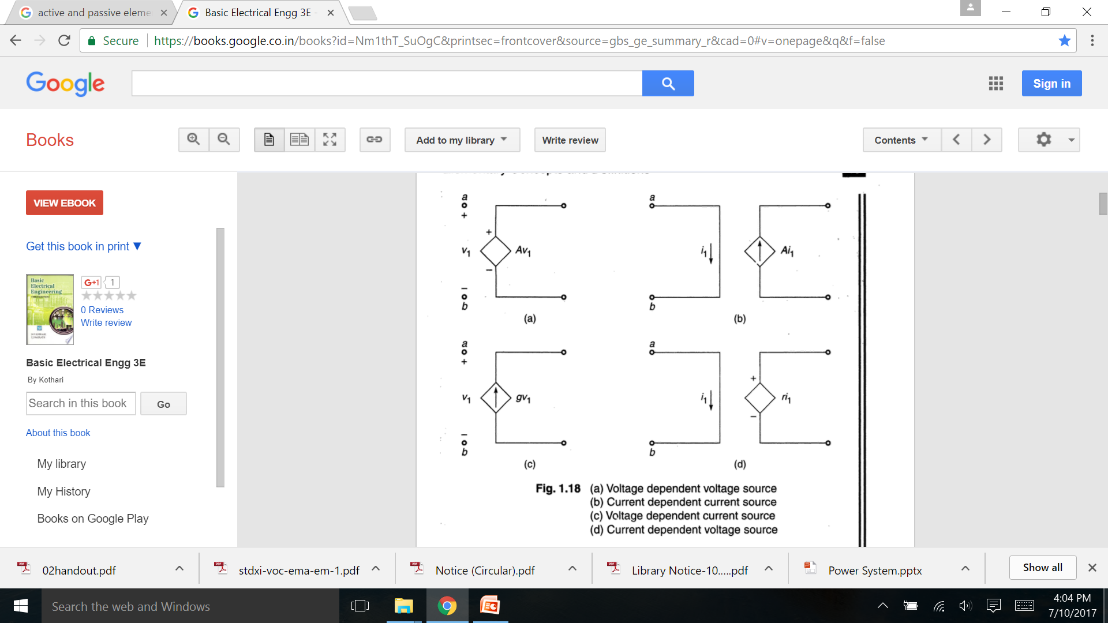
Voltage and current sources(dependent)

Slide 7
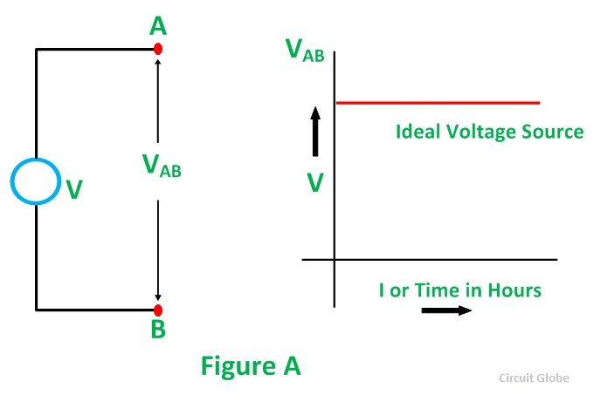
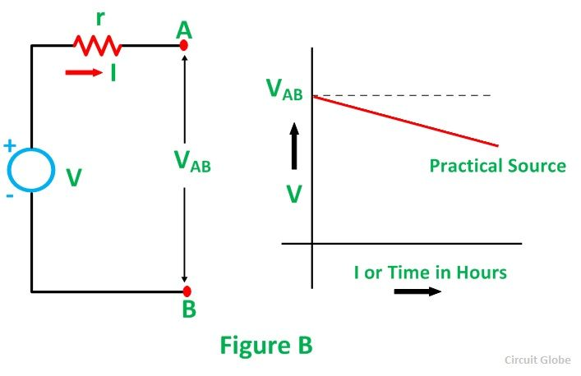
Ideal Voltage Source
A voltage source is a two-terminal device whose voltage at any instant of time is constant and is independent of the current drawn from it. Such a voltage source is called an Ideal Voltage Source and have zero internal resistance. Practically an ideal voltage source cannot be obtained. Sources having some amount of internal resistances are known as Practical Voltage Source, due to this internal resistance; voltage drop takes place, and it causes the terminal voltage to reduce.

Slide 8
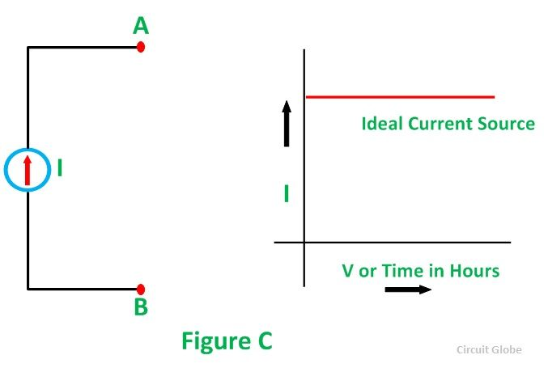
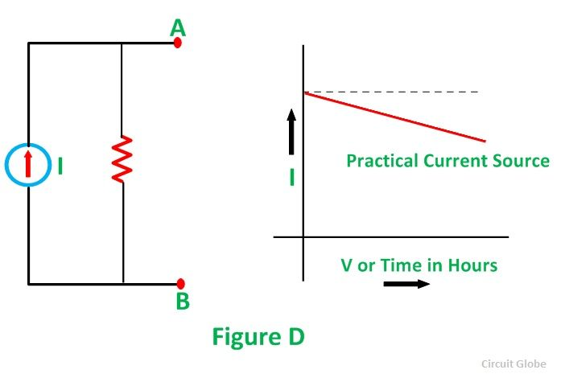
Ideal current source
An Ideal current source is a two-terminal circuit element which supplies the same current to any load resistance connected across its terminals. It is important to keep in mind that the current supplied by the current source is independent of the voltage of source terminals. It has infinite resistance.

Slide 9
Passive Components
Components that cannot provide any power gain to the circuit are called passive devices. These devices are incapable of controlling the current (energy) flow in the circuit and need the help of active devices to operate. Some examples for passive devices are resistors, inductors and capacitors.
Although passive components cannot amplify a signal with a gain more than one, they can multiply a signal by a value less than one. They also can oscillate, phase shift and filter signals. Some passive components also have the capability to store energy (drawn from an active element) and release later. Example: capacitors and inductors.

Slide 10
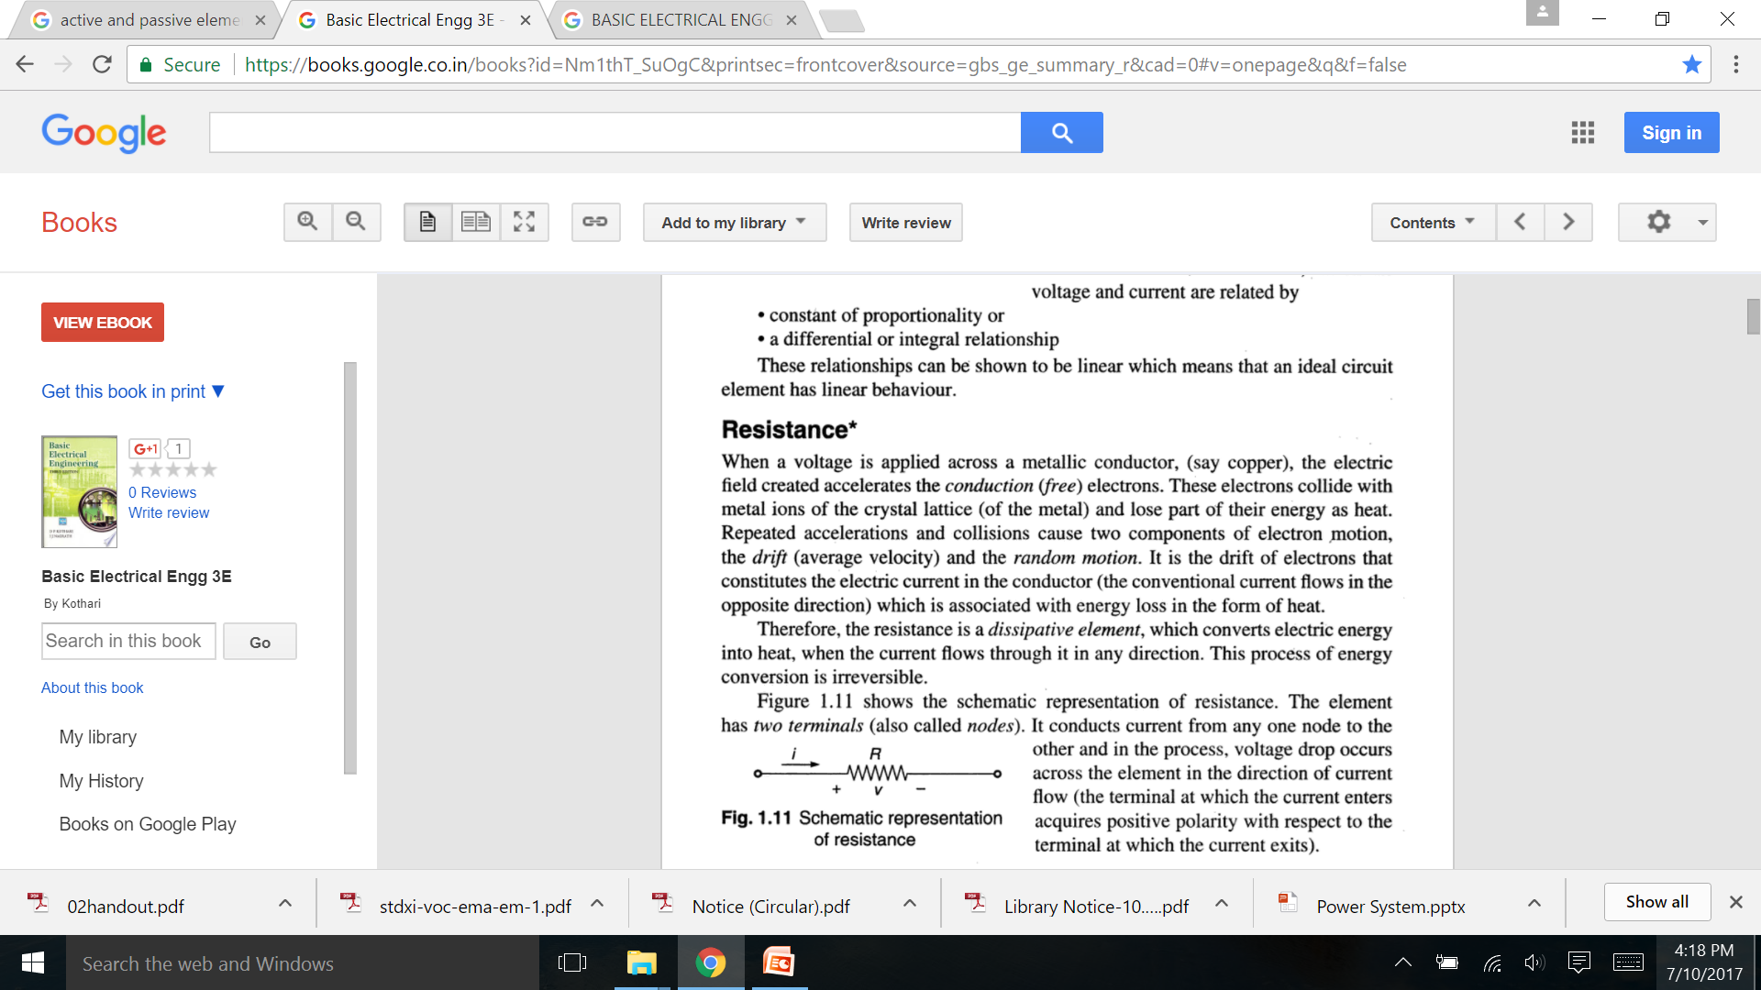
Resistance

Slide 11
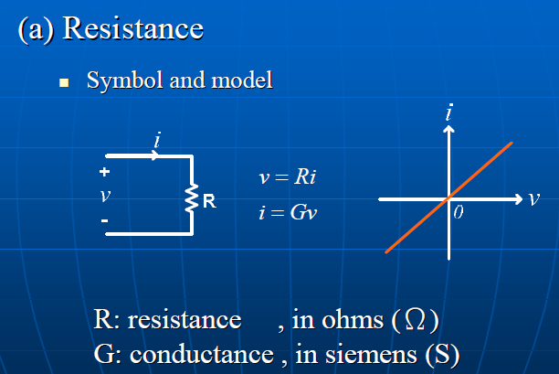
Resistance

Slide 12
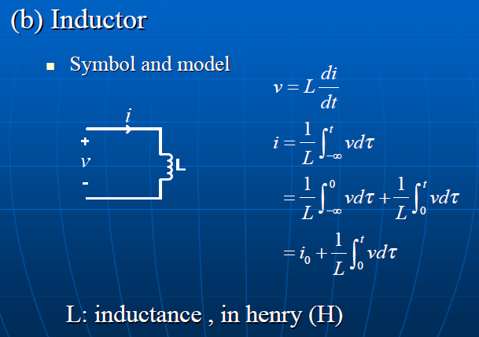
Inductor

Slide 13
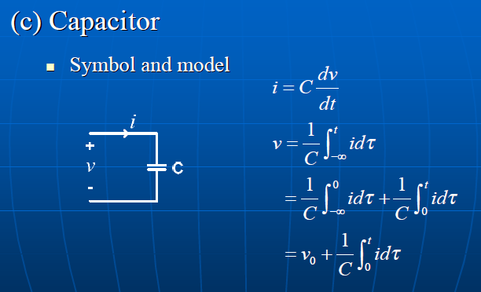
Capacitor

Slide 14
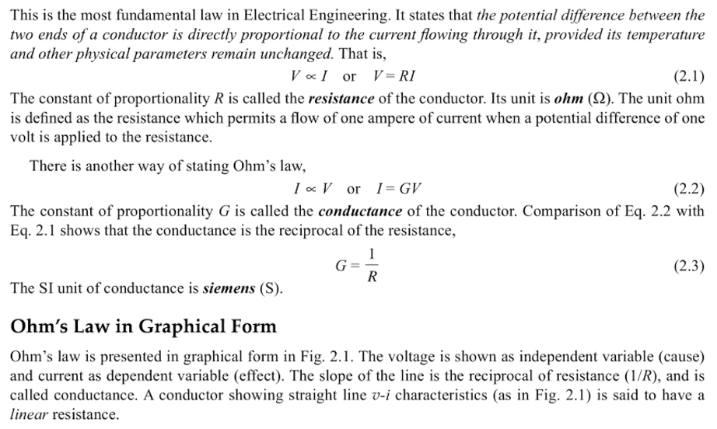
OHM’s Law

Slide 15
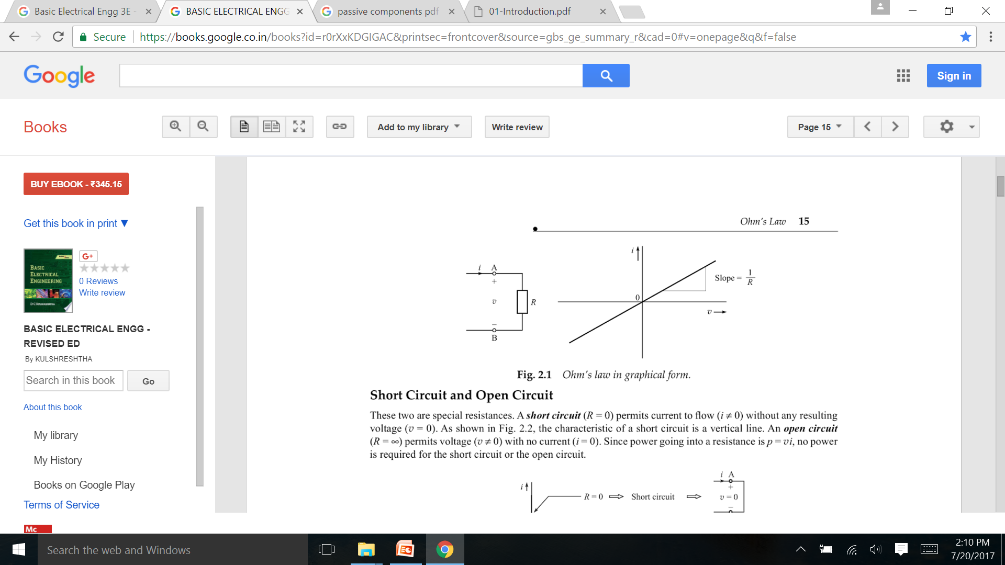
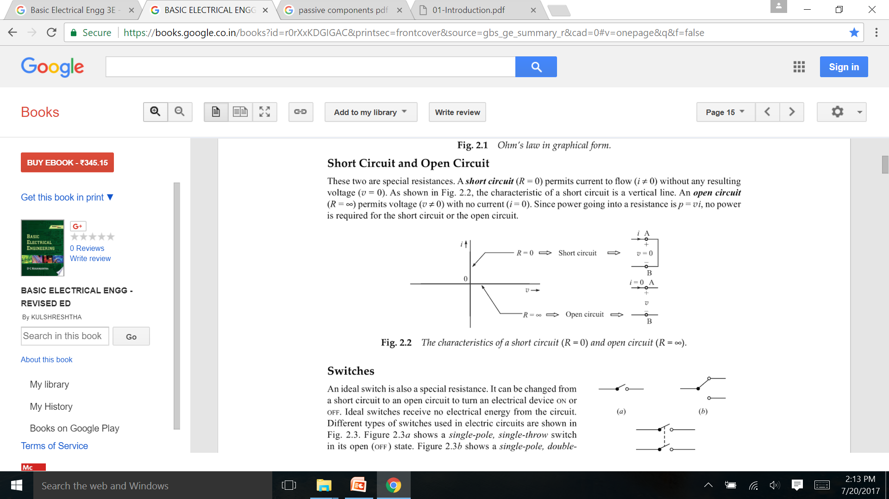

Slide 16
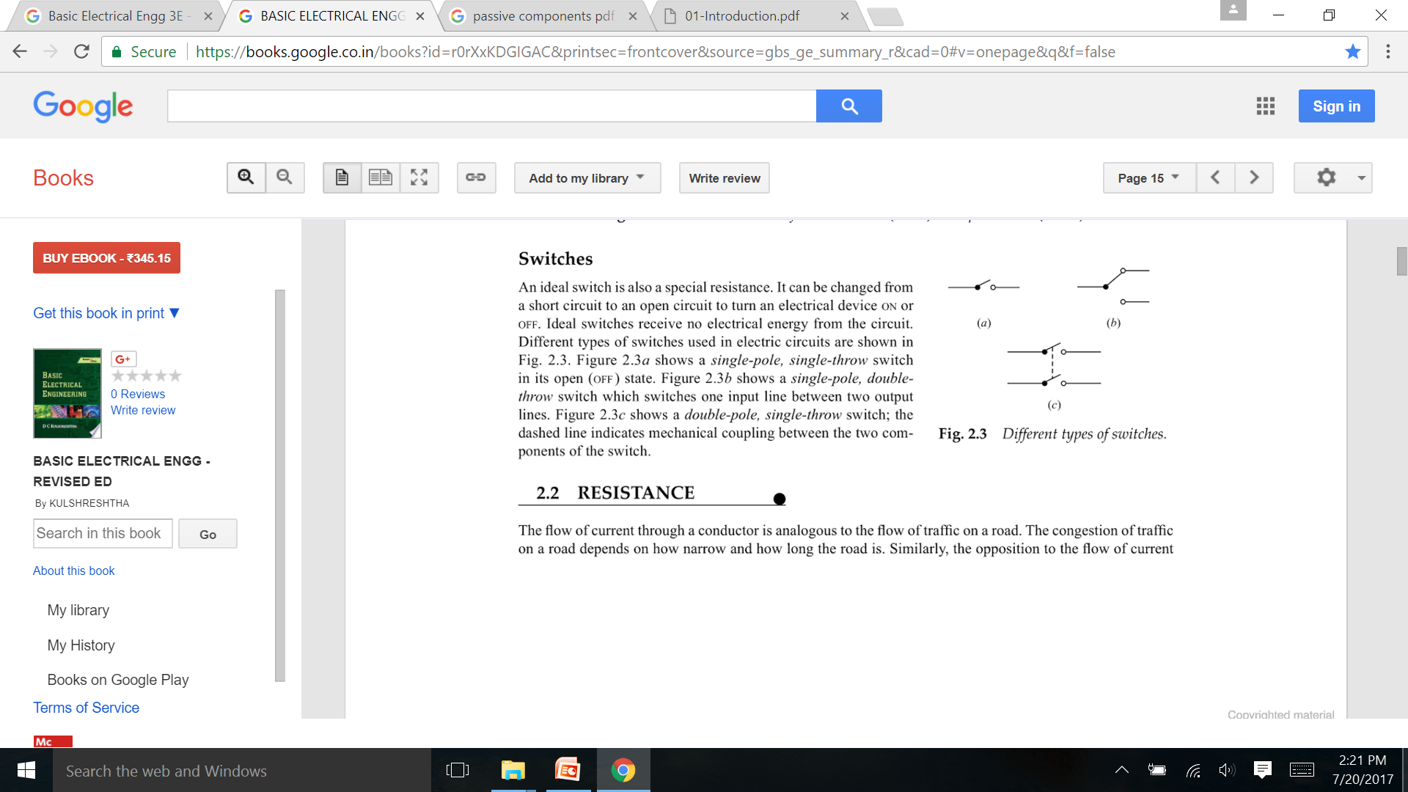
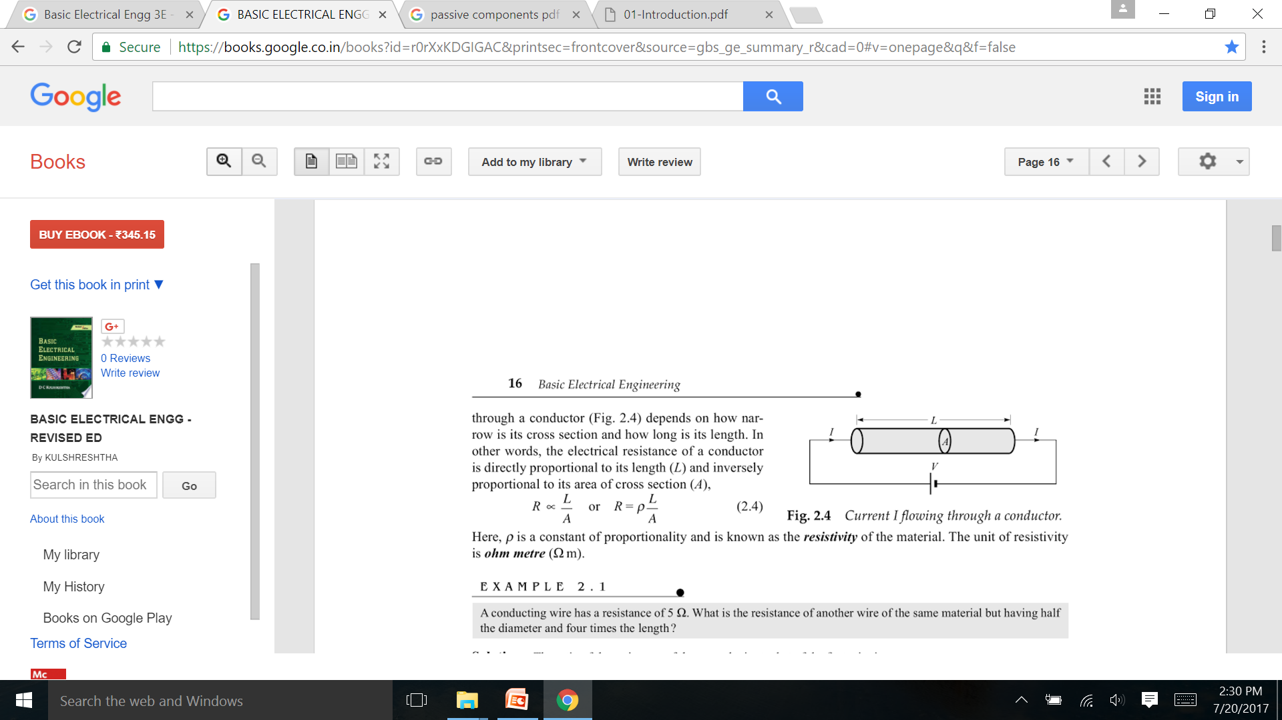
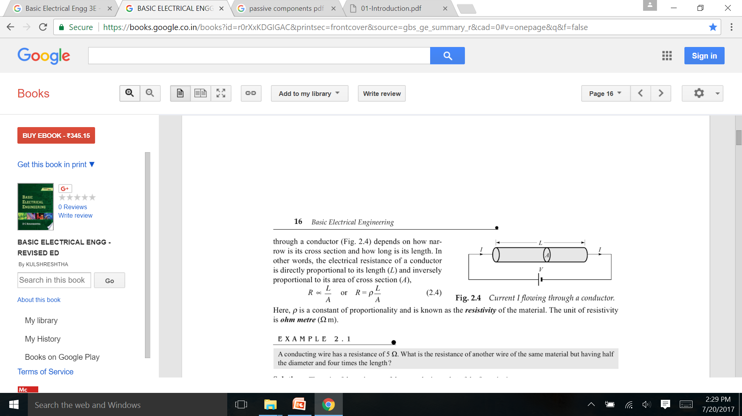
Switches

Slide 17
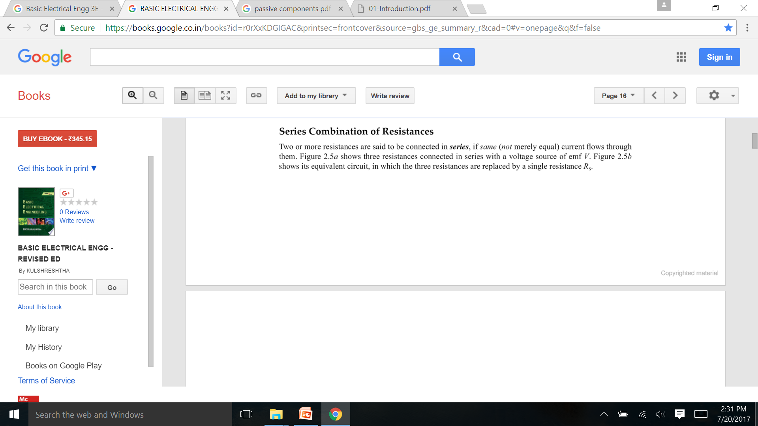
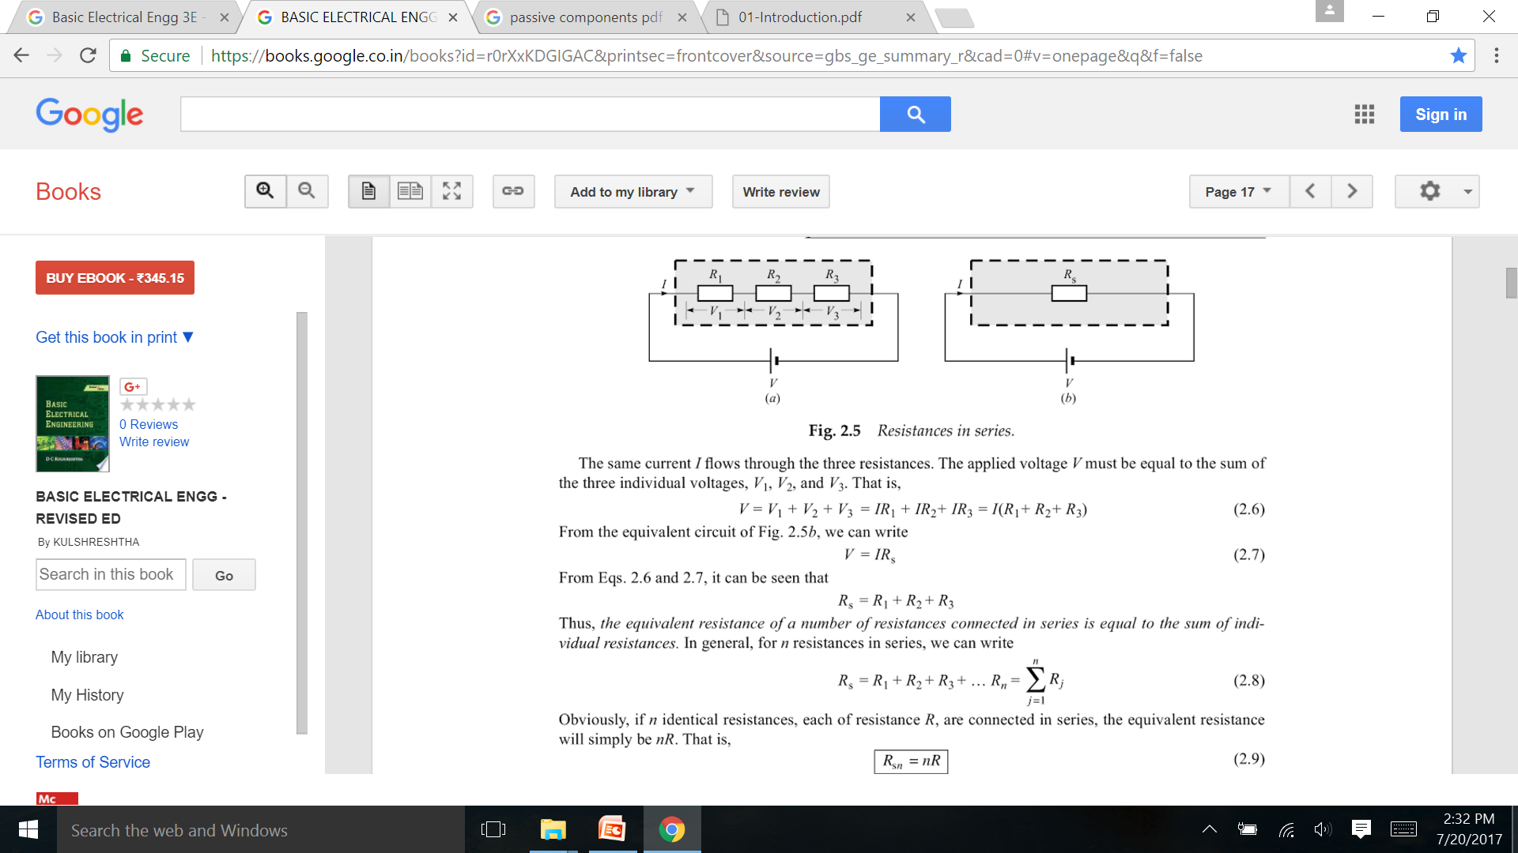
Series Combination of Resistance

Slide 18
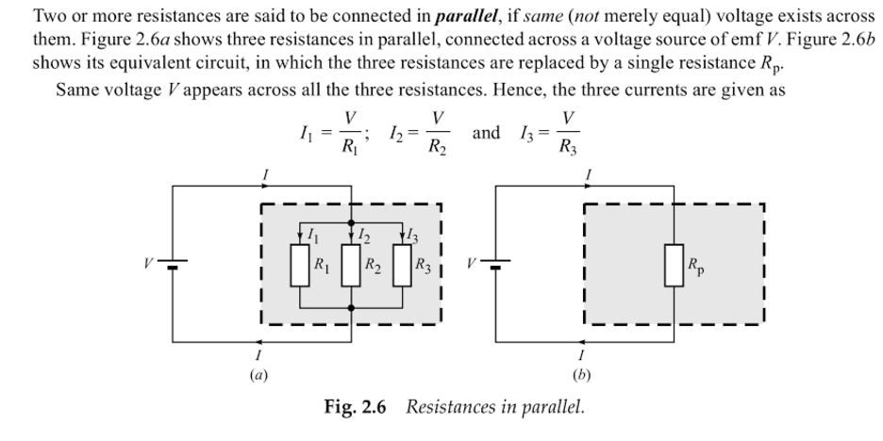
Parallel Combination of Resistance

Slide 19
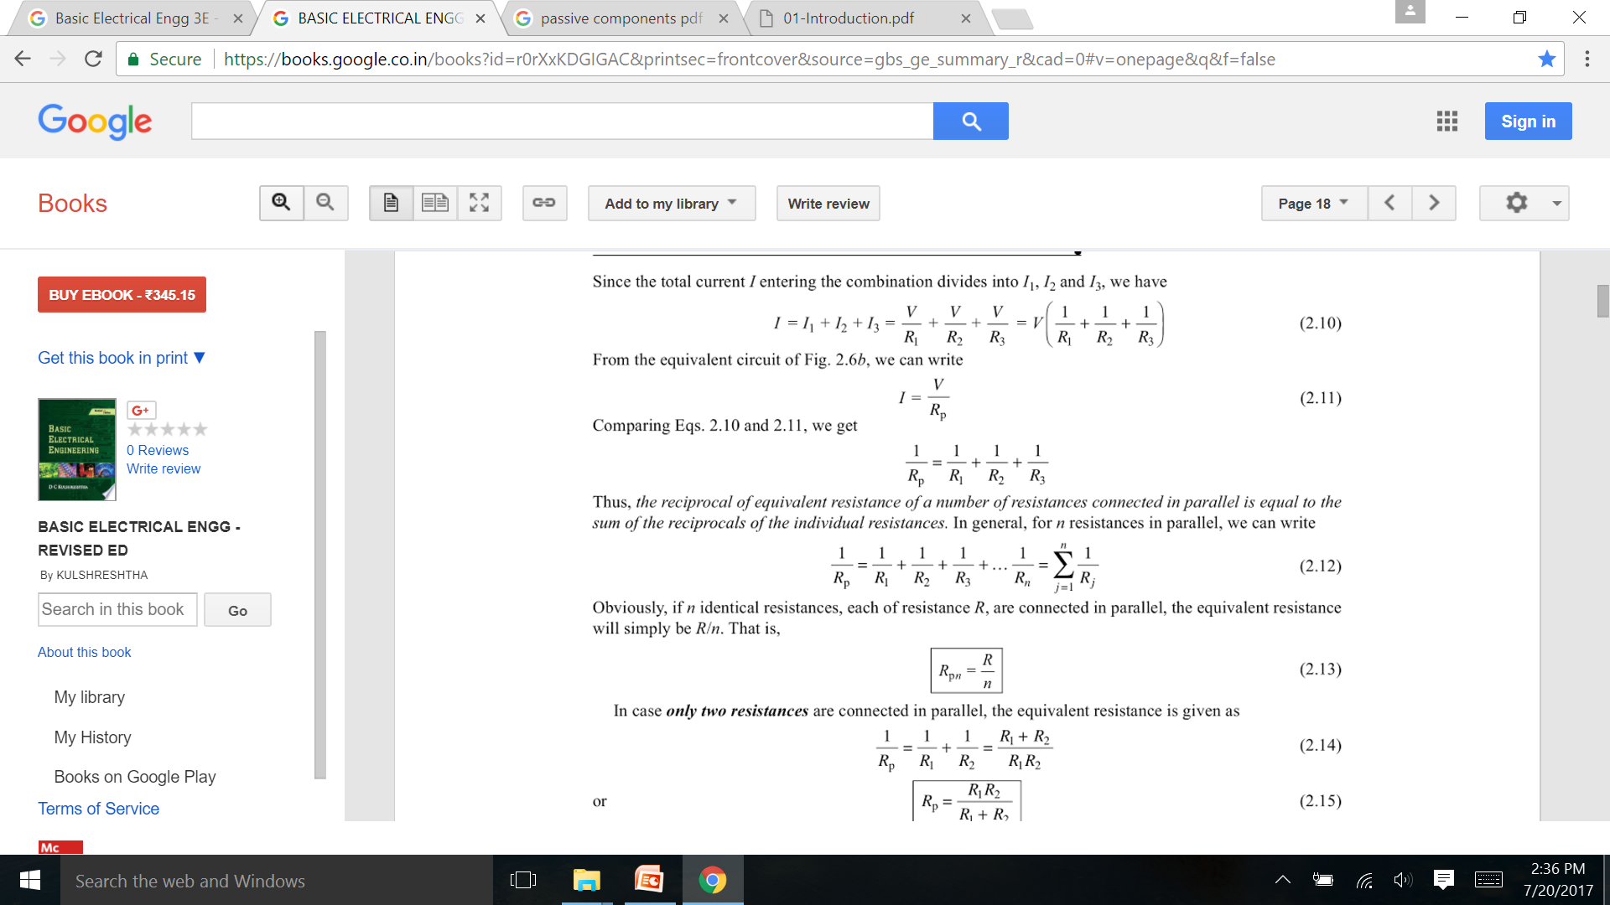
Parallel Combination of Resistance

Slide 20
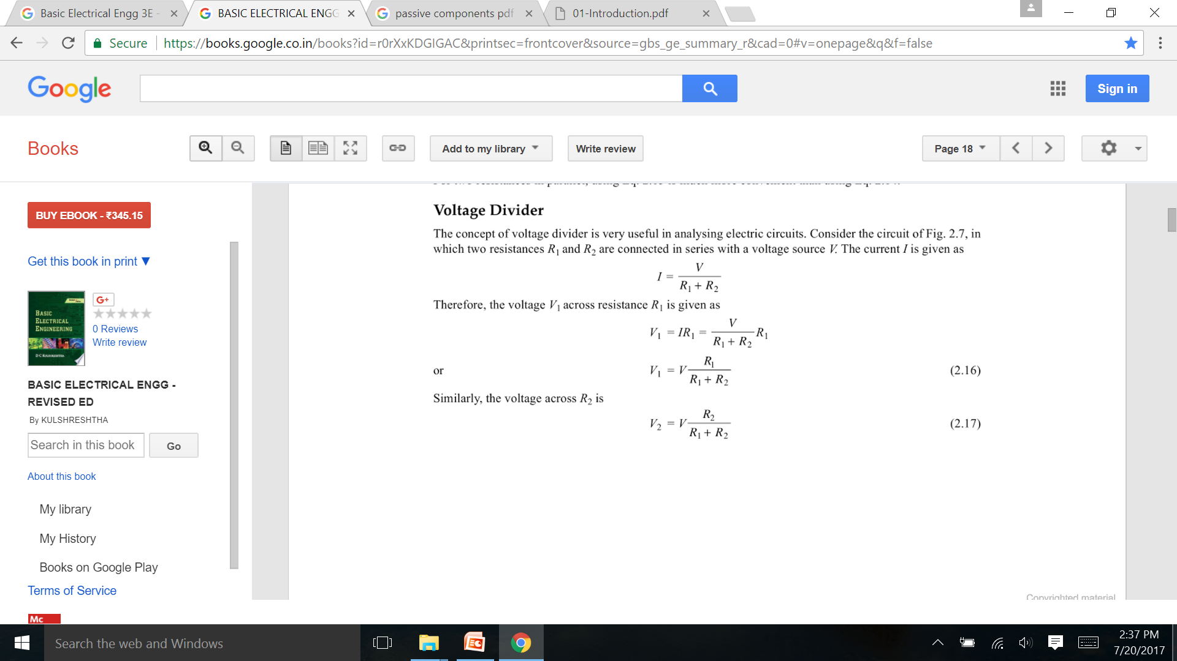
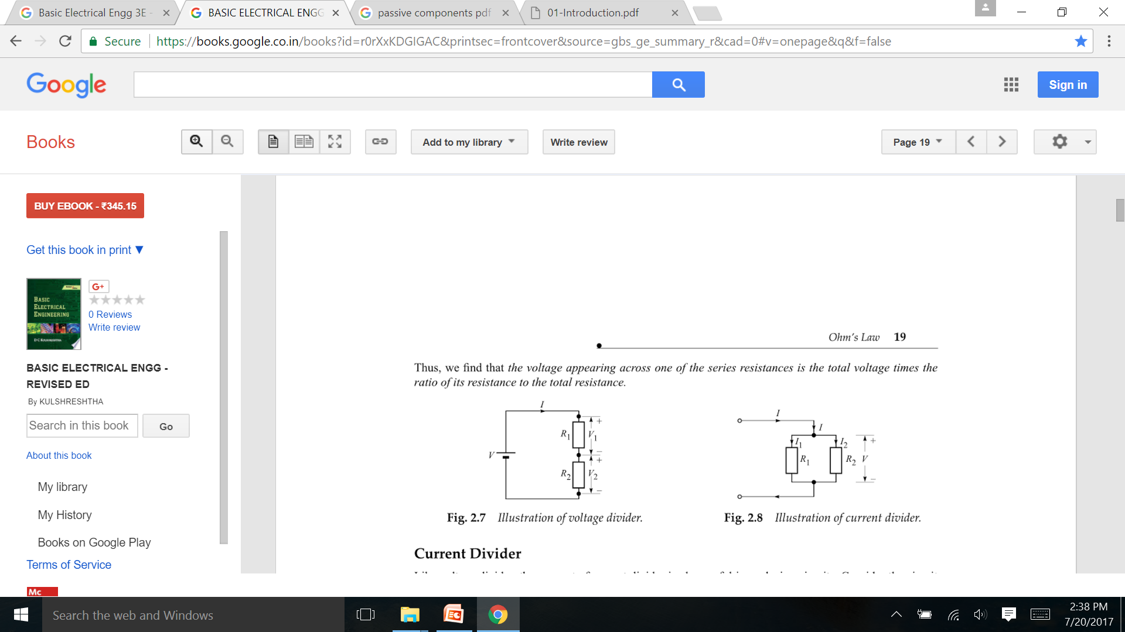
Voltage Divider

Slide 21
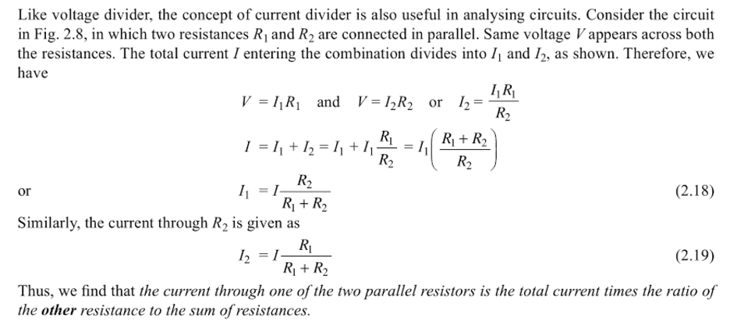
Current Divider

Slide 22
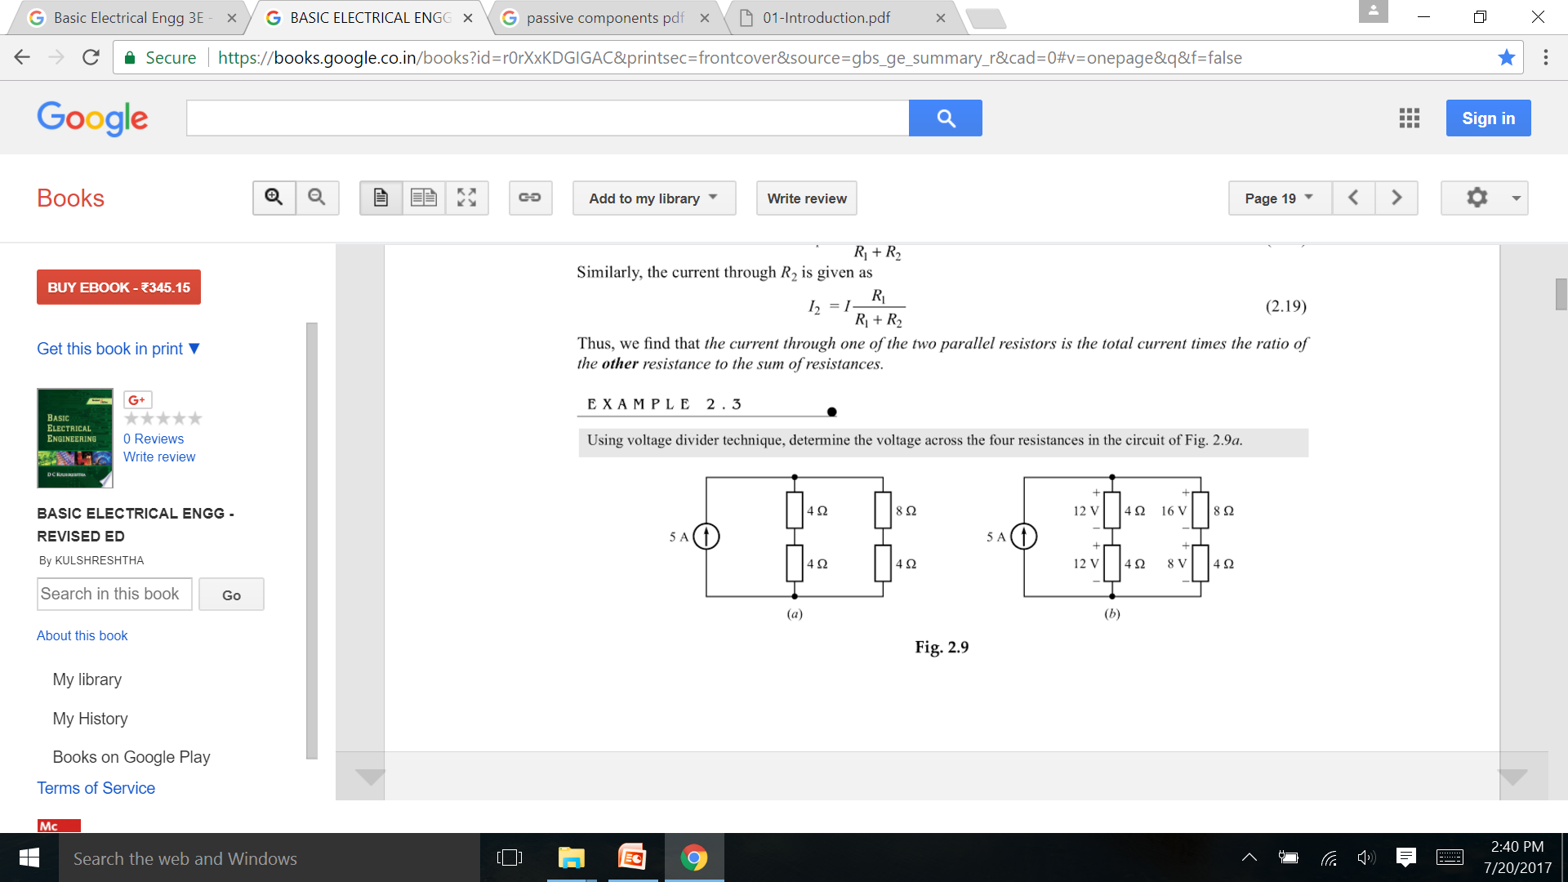
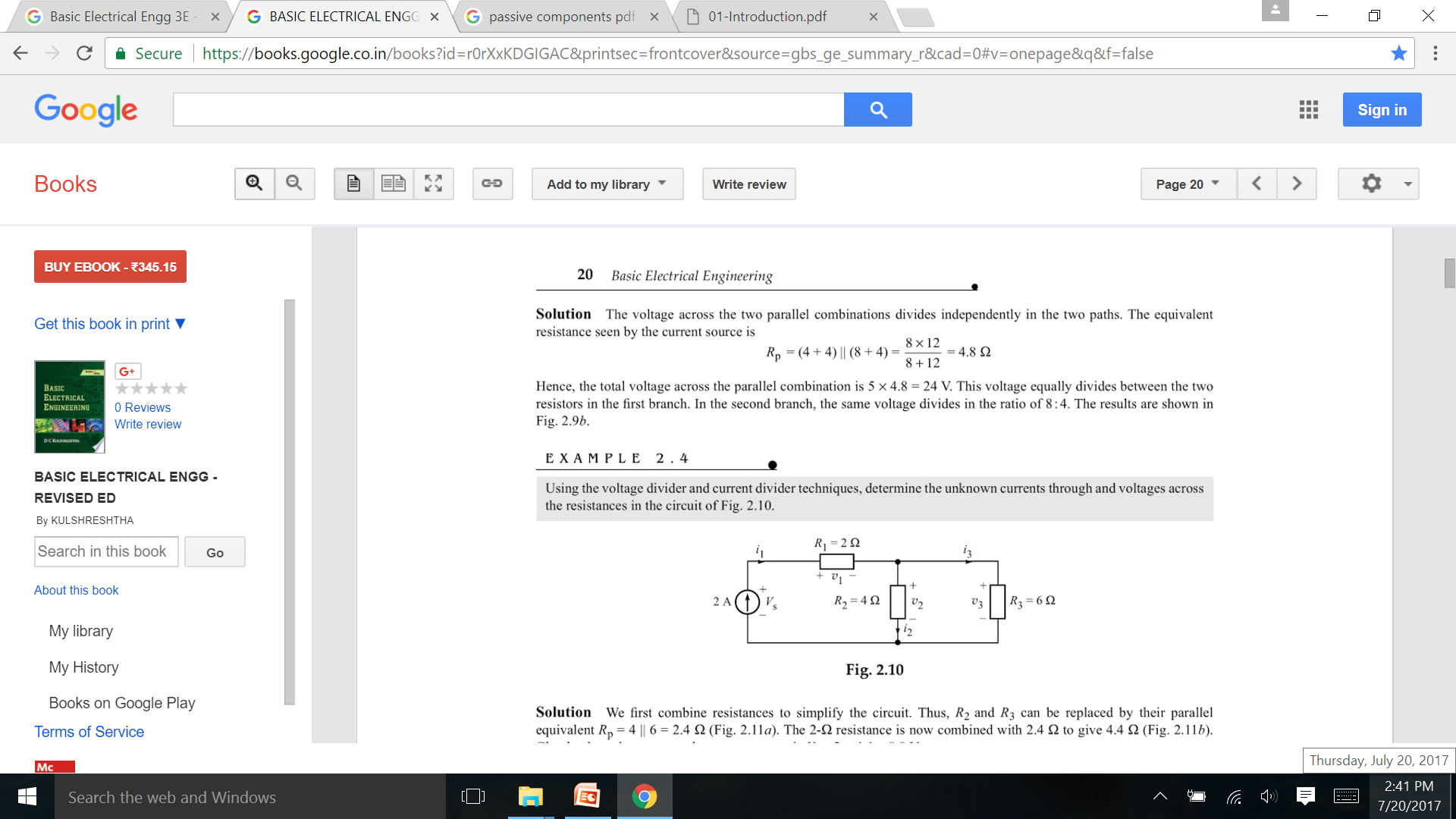
Example

Slide 23
Thank you

